Slide 1


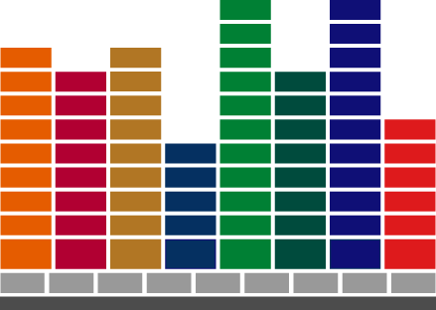

Slide 2
Sales Configurator
Functional overview

Slide 3
History and versions
SCONF
IFS Apps
Exactium
7.5
No support
-99
Exactium/IFS
7.6
No support
2000
IFS owned
8.0
No support
2001-3
CTO integration
VAP
8.1
Project Volterra XML
2002
Core
8.2
On- and Offline
2004
8.3
Unicode
App7

Slide 4
CTO Basics
Manufacturing Rules
  Determines how a configured product is manufactured.
  Defined in IFS/CTO
Sales Pricing Rules
  Determines sales price for configured part. Acts as an add-on to the sales part’s list price.
  Defined in IFS/CTO
Notes:
CTO Basics or why we need the sales configurator. It fills a gap that we are currently missing in ”standard” IFS Applications.
Manufacturing Rules: Controls the shop order components and operations by rules defined in the configurable structure and the configurable routing.

Slide 5
CTO Basics
Manufacturing Rules
Part 156 is selected when characteristic “GDFINISH” equals “1”
Quantity per assembly for part 156 is set to formula GDWIDTH-M [Characteristic GDWIDTH / 1000]

Slide 6
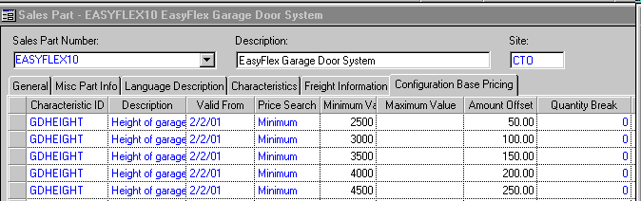

CTO Basics
Sales Price Rules
If GDHEIGHT is > or = to 3500 and < 4000, add $150 to base price
If GDREMOTE=“IR”, add of $30 + ($13 x number of units) to base price

Slide 7
Sales Rules
Determines “legal” configuration for configured part during configuration entry by for instance:
  Checking validity for variable value characteristics
  Making options or option values available or unavailable
  Automatically selecting option values
Defined in Sales Configurator Workshop
Notes:
Making option values for discrete option characteristics available or unavailable based on entered option values
Automatically selecting option values by combinations of previously entered characteristic values

Slide 8
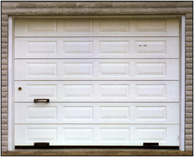
Sales rules examples:
Variable validations
Must be greater or equal to 2,500 mm.
And can not exceed 5,000 mm.
Height
Width
Must be greater or equal to 2,500 mm.
And can not exceed 7,000 mm.
Notes:
Garage door height can only be between 2,500 and 5,000mm
Garage door width can only be between 2,500 and 7,000mm.

Slide 9




Sales rules examples
Choice Exceptions
Country
Europe
UK
North America
Power System
115 Volts
240 Volts
400 Volts
Notes:
If EUR (Europe) or UK (United Kingdom) is chosen as the country, the user can not select 115 volts.
If NA (North America) is chosen as a country, the user can not select 400 volts.

Slide 10
Sales rules examples
Set Defaults
Country
Europe
UK
North America
Power System
115 Volts
240 Volts
400 Volts
Notes:
If EUR (Europe) is chosen as the country, the user can not select 115 volts, 400 volts is set as the default, but the user can change the selection to 240 volts.
If UK (United Kingdom) is chosen as the country, the user can not select 115 volts, 240 volts is set as the default, but the user can change the selection to 400 volts.
If NA (North America) is chosen as a country, the user can not select 400 volts, the default is set to 115 volts, but the user can still select 240 volts.

Slide 11
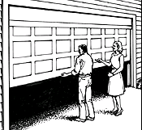

Sales rules examples
Auto Selection
Country
Europe
UK
North America
Emergency Stop
Basic
Childproof
Notes:
Emergency Stop is a non-mandatory characteristic.
If NA (North America) is chosen as the country, the Childproof Emergency Stop system must be included. The user can not choose the Basic Emergency Stop system.

Slide 12
Demo in IFS/CTO

Slide 13
IFS/Sales Configurator Integration
Sales Configurator integration for Configuration Family established when sales part created for configurable part
Sales Configurator Client runs in “invisible” background mode during IFS/CTO configuration entry
User updates IFS/CTO with Sales Configurator Workshop information manually by creating a “version”
Notes:
The Sales Configurator consists of two parts, The Workshop where the rules are set up and the client that executes the rules.
Sales Configurator integration for Configuration Family established (i.e. characteristics and option values become available in workshop) when sales part created for configurable part within family
Sales Configurator Professional runs in “invisible” background mode during IFS/CTO configuration entry
User updates IFS/CTO with Sales Configurator Workshop information manually by creating a “version” which updates IFS/CTO when it is invoked.

Slide 14
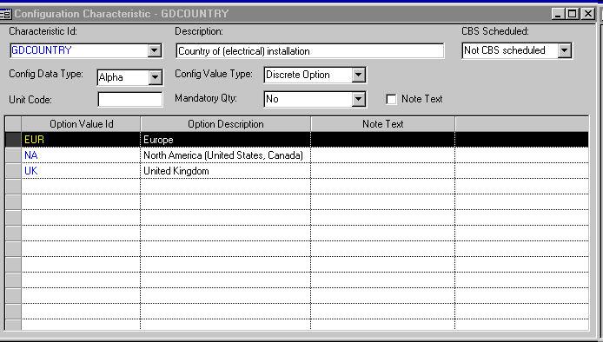

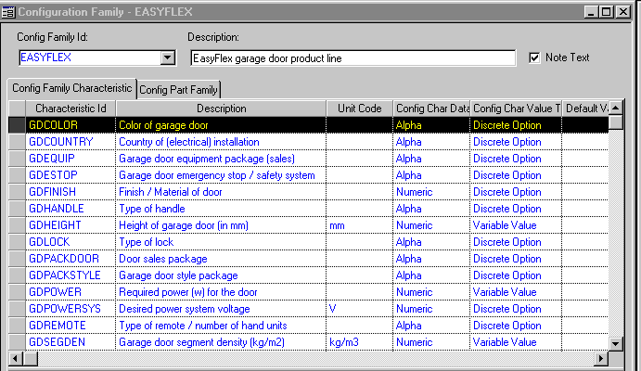
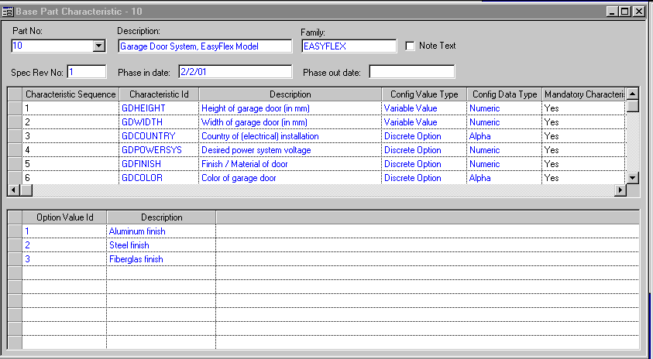
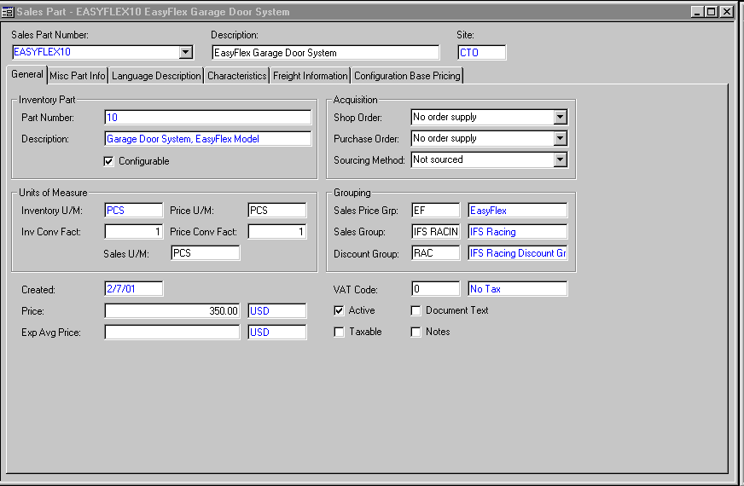

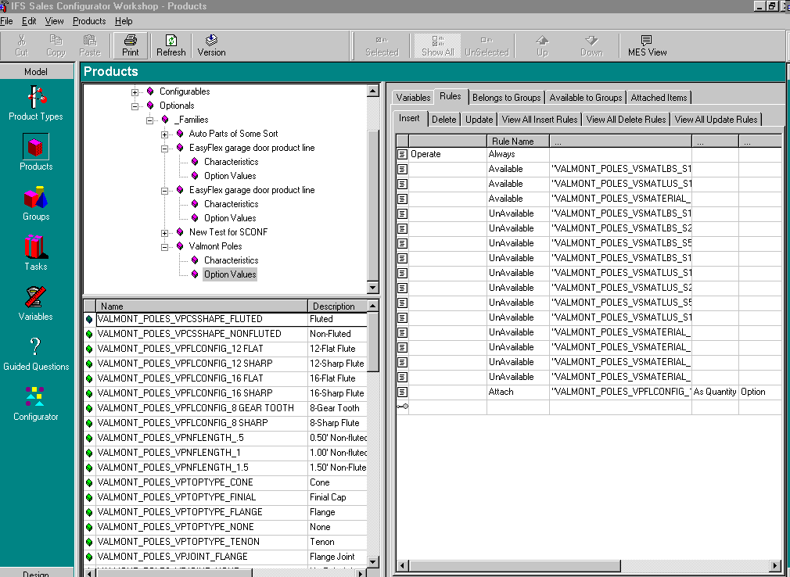
Base Set-up
Configuration Family
Base Part
Characteristics
Characteristics
Configuration Family
Base Part
Sales Part
Family
Configurable
Characteristics
Option Values

Slide 15
Adding Characteristics and/or Option Values
Add Characterics and/or Option Values
Characteristics
Add to Configuration Family
Configuration Family
Add to Base Part
Base Part

Slide 16
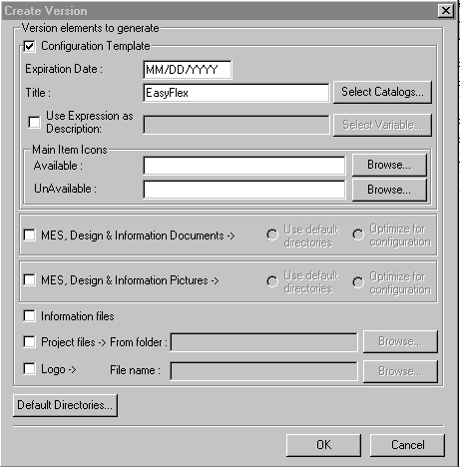
Making Rules Available for IFS
Enter/Maintain Rules
In Workshop
Create Version for Catalog
Oracle
Database
Flat File
XXXX.xtm
(not used)
Shared with
IFS Apps

Slide 17
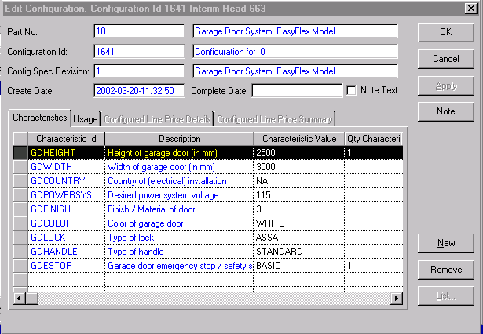
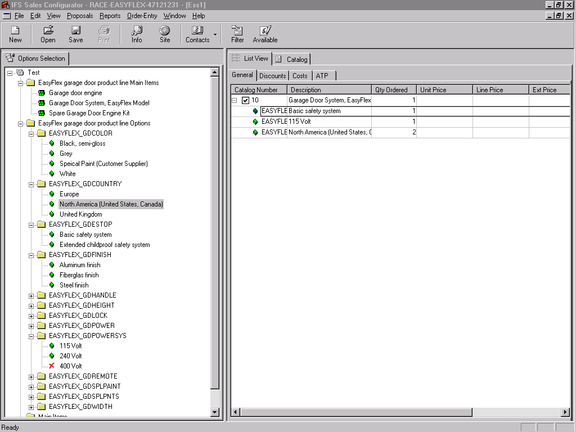
Accessing Sale Rules in IFS
Create/Edit Configuration
Sales
Rules?
Oracle
Database
Yes?
Sales Configurator
Professional
(Invisible!)
Shared with
Sales Configurator

Slide 18
Sales Configurator Workshop
Usage
  Used to create rules for IFS Sales Configurator Client
  Extends rules capabilities for IFS/CTO
  Runs as a 3rd party application with different user interface than standard IFS Windows or Web interface
  Uses IFS/CTO data as a basis for rules creation

Slide 19
Sales Configurator Workshop
Basic sales rules
  Attach
  Detach
  Unavailable
  Available
  Message
  Set

Slide 20
Basic Sales Rules
Attach
Allows the automatic selection of an option value for a discrete option characteristic or the inclusion of a non-mandatory variable value characteristic.
Used to:
  set a default for a discrete option characteristic
  select automatically included options (e.g. the “sports package” includes racing wheels and a CD player)
  make a non-mandatory discrete option characteristic available by selecting one of the options
  make a non-mandatory variable value characteristic available

Slide 21
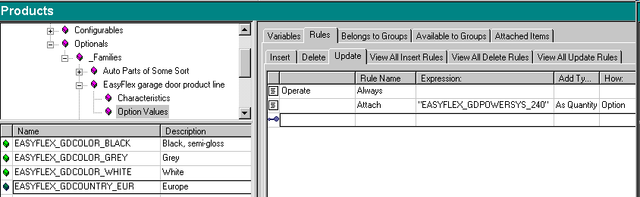
Basic Sales Rules
Attach Example
If the user chooses country Europe (GDCOUNTRY = EUR) it makes 240 the default for the garage door power supply (GDPOWERSYS = 240)
Notes:
. If the user chooses Europe (GDCOUNTRY = EUR) as the country it makes 240 the default for the garage door power supply (GDPOWERSYS = 240)

Slide 22
Basic Sales Rules
Detach
Allows removal of an option value for a discrete option or a variable value characteristic
Used to:
  remove a previously selected option value
  remove a non-mandatory variable value characteristic

Slide 23
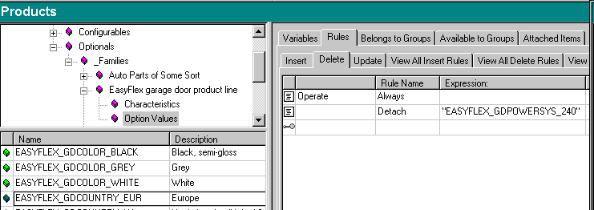
Basic Sales Rules
Detach Example
If the user chooses to change Europe as the country then 240 may be “de-selected” for the garage door power supply (GDPOWERSYS)

Slide 24
Basic Sales Rules
Unavailable
Makes an option value for a discrete value characteristic unavailable (or invisible) for selection
Used to:
  make an option values unavailable for discrete option characteristics
  to insure “legal” selection of option values when used with “available”

Slide 25
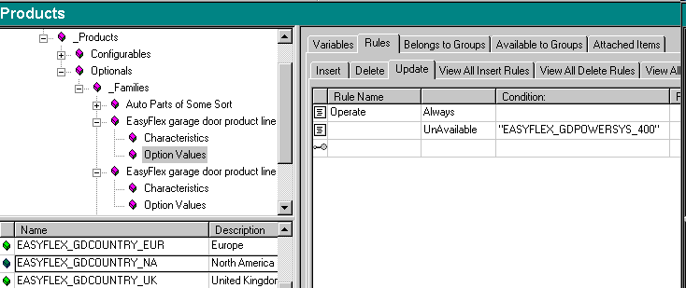
Basic Sales Rules
Unavailable Example
When selecting North America for country (GDCOUNTRY = NA), 400 is not allowed as a selection for garage door power supply (GDPOWERSYS can not = 400)

Slide 26
Basic Sales Rules
Available
Makes an option value available (or visible) for selection
Used to:
  make an options value available for discrete option characteristics
  to insure “legal” selection of option values when used with unavailable

Slide 27
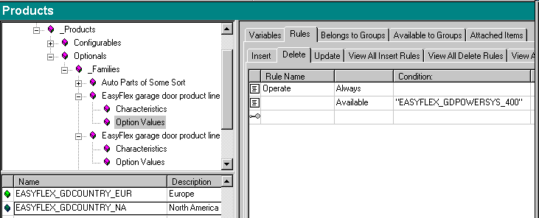
Basic Sales Rules
Available Example
When the user is changing the selection for country (GDCOUNTRY no longer = NA) from North America, 400 is now allowed as a selection for garage door power supply (GDPOWERSYS can = 400)
Notes:
When making an option value available, the option value must be have been set-up in IFS/CTO for the characteristic for the base part.

Slide 28
Basic Sales Rules
Message
Sends a message to the dialog box
Used to:
  Check validity of entry for variable value characteristics
  User information

Slide 29
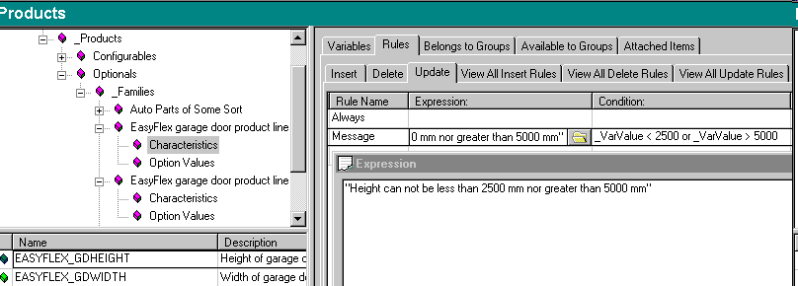
Basic Sales Rules
Message Example
The garage door height (GDHEIGHT) can not be less than 2500 mm nor more than 5000 mm

Slide 30
Basic Sales Rules
Set
Sets value for characteristic
Used to:
  Set a value for a variable value characteristic.
  (Note: Required when attaching a variable value characteristic to make it available for IFS/CTO)

Slide 31
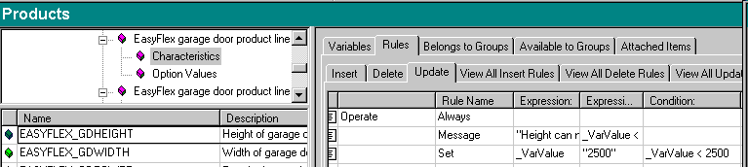
Basic Sales Rules
Set Example
When entered value for the garage door height (GDHEIGHT) is below the minimum (2500), the value is set to the minimum.

Slide 32
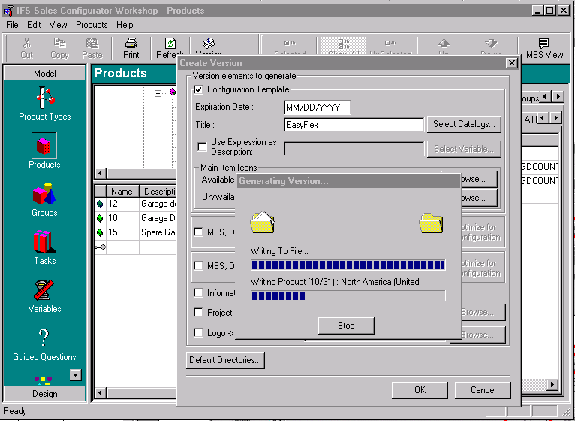
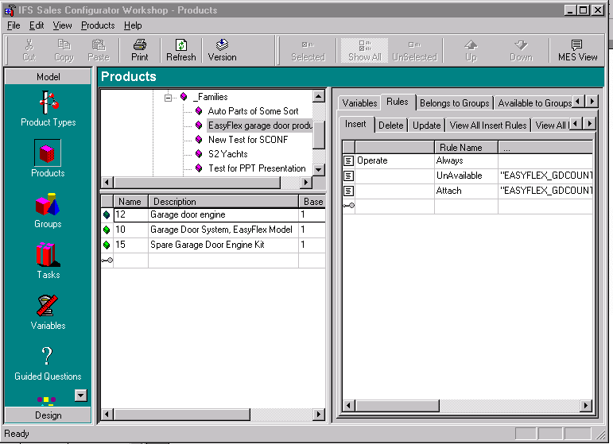
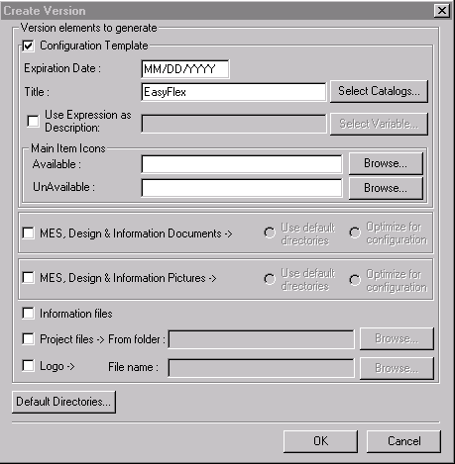
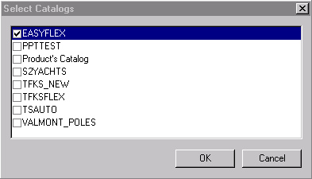
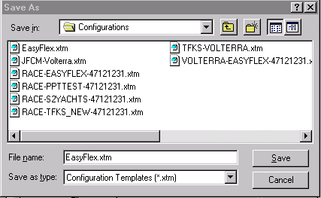
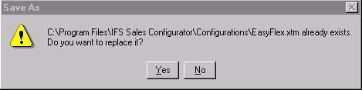
CTO Configuration Rules
Building Versions
Doesn’t Matter!

Slide 33
Building a Version
Steps in IFS CTO
  Once a version is created in the Sales Configurator Workshop, it becomes available immediately in the IFS CTO dialog box.
  Create a new Configuration
    As the new Configuration Dialog Box opens, the new configuration rules are in effect
    The new rules have an expiration date that corresponds with the date in set by the “Create Version” dialog box in the Sales Configurator Workshop.

Slide 34
IFS/CTO & Sales Configurator
Terms Mapping
IFS/CTO | Sales Configurator
Configuration Family | Family/Catalog
Base Part | Configurable
Characteristic | Optional
Variable Value | Characteristic
Discrete Option | Option Value

Slide 35
Demo: Workshop walkthrough
Show Basic Rules from the previous slides
Terms mapping
Creating version

Slide 36
Sales Configurator Workshop
Advanced
Groups
  Connection between CTO setting and SCONF
    Base Part Characteristics
    Available Items, Enable Groups, Attached Items.
    Is needed to get same behaviour offline as online.
Screens
  User configured pop-up windows

Slide 37
Offline functionality
Drag and drop configuration
Info from back-office
  Customers
  Prices
  Exchange rates
Extras
  Guided questions
  Reports
  MES

Slide 38
Offline Sales Configurations
Solution—Prerequisites
Integrates with IFS Connect
  Connection path to the Web services
  XML interface of sales quotations
  and customer orders
Requires the configure-to-order
solution in IFS Applications
Supported version from IFS 2003-2
Upgrades from Sconf 8.1
Basic settings are the same as for the
online mode
Uses SOAP/XML for transferring data
Notes:
Purpose of slide: Describes the prerequisites for being able to work offline.
Things to say:
Integrates with IFS/Connect.
Uses SOAP/XML for transferring data.
The connection path to the web services must be set up in the client.
Uses IFS/Connect for an XML interface of sales quotations and customer orders.
Requires the Configure-to-Order solution in IFS Applications.
Supported version from IFS 2003-2
Upgrades from Sconf 8.1
Basic settings are the same as for the Online mode.

Slide 39
Offline Sales Configurations
Solution—Price Integration
Pricing integration with the
CTO solution in IFS Applications
  Base prices
  Price lists (including characteristic
  pricing)
  Discounts
  Customer agreements
  Exchange rates
IFS Applications
is the source for
pricing
Notes:
Purpose of slide: Describes the price integration between IFS Applications and the Sales Configurator.
Things to say: Integration of pricing between IFS Applications and Sales Configurator Workshop/Client—IFS Applications is the source for pricing. Supports base prices, price lists (including characteristic pricing), discounts (multiple discount is not supported, order discount only works as a total order value deduction and will be deducted when the order is released in IFS Distribution, order line discounts cannot be handled in IFS Sales Configurator), customer agreements, and exchange rates. Note that this is an offline solution, prices or the like are not retrieved online. Prices will not be transferred in the ORDERS message, the price will be re-fetched when invoking the order in IFS Distribution.

Slide 40
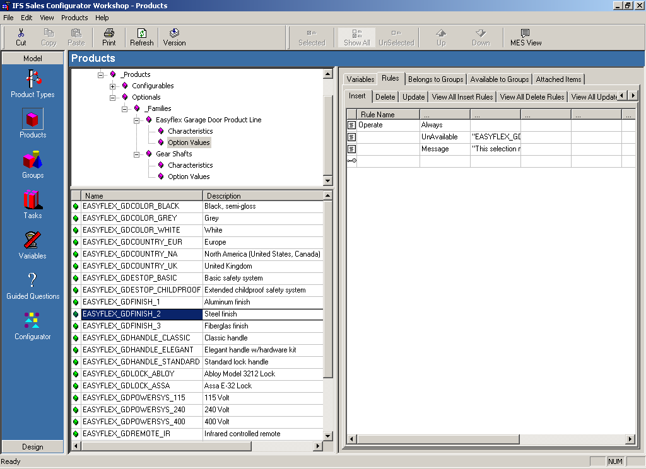
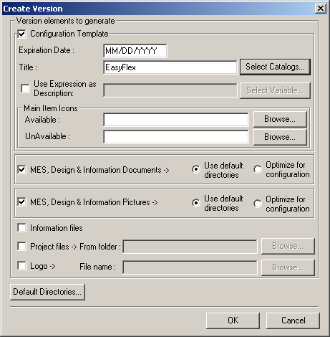
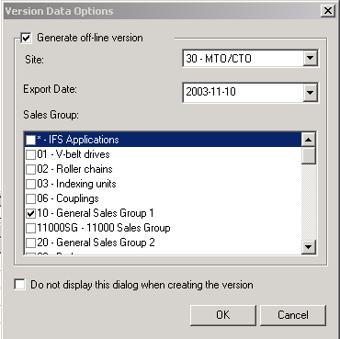
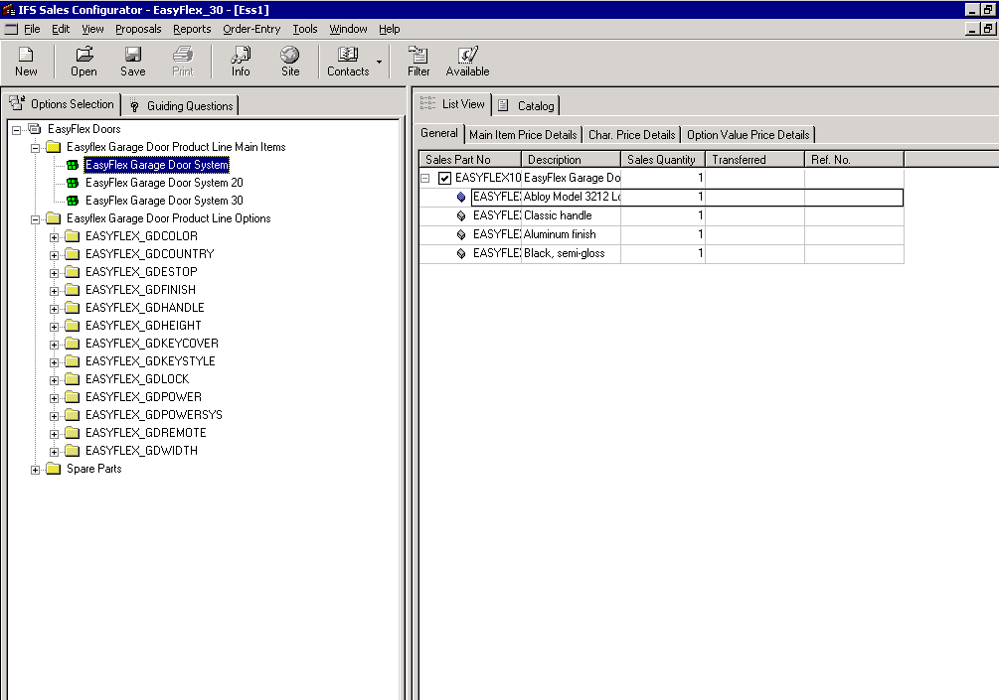
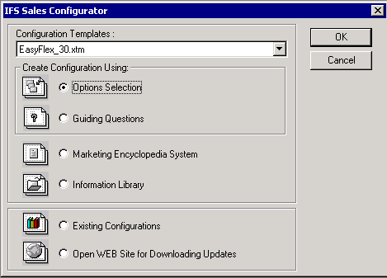
Offline Sales Configurations
Solution—Make Versions Available
Enter/maintain rules
in Workshop
Select online or offline mode
Create version for catalog
Catalog
Rules
Graphics
Database
Customers
Prices
Exchange Rates
Version
.XTM
Notes:
Purpose of slide: Shows how a version is made available for use by a sales representative. The rules, etc., come from the Sales Configurator Workshop, whereas the customer, price and exchange rates come from the IFS database. This slide contains animations on mouse-clicks.
Things to say: In the first step of making a Version, chooses between making a Version for Offline or Online purposes. When selecting the Offline mode, the system fetches information both from IFS Applications and Sales Configurator and combine those into a ‘compiled’ Version file which can be distributed to end-users in a varies set of ways, for instance by mail, download from an Internet site, or retrievable from an FTP-site, etc.

Slide 41
Offline Sales Configurations
Solution—Transfer Orders/Quotations
Sales Configurator
Client
Sales Quotations
Customer Orders
-or-
Transfer
Configuration
Approve
Order
In Messages
Incoming
Customer
Orders
XML
Message
Notes:
Purpose of slide: Shows how customer orders and sales quotations are transferred from the Sales Configurator Client to IFS Applications.
Things to say: The configurations are transferred from the Sales Configurator client through XML messaging (IFS/Connect). The information is transferred by using the ORDERS message. The information is put in the Incoming Customer Orders window (which can handle both sales quotations and customer orders. The approval process turns the information into sales quotations or customer orders. The approval can be done automatically if required.

Slide 42
Demo of offline client

Slide 43
Workshop walkthrough II
Offline functionality
  Reports
  MES
  Guided Questions
Advanced Online functionality
  Screens

Slide 44
Technology
Programming mostly C++
Different tools have been used historically to build setups
  Used to be Install Shield, but currently Visual Studio .NET
ODBC connection is used for Workshop database connection
  App7: Oracle’s ODBC
  2004 and back: Microsoft’s OBDC for Oracle
.NET 1.1 (or over) must be installed on the client computer
  This concerns the App7 release
Two verisons of SCONF cannot be installed on the same computer at the same time

Slide 45
The SCONF/CTO Scenario - 2
A Stand-Alone Solution
Sales Configurator
Client
OFFLINE
An Online integrated Solution
Sales Config
ORDERS
Foundation1
IFS Connect
IFS Extended Server
ONLINE
Version
XML
Sales Configurator
Workshop + IFS CTO
CTO
IFS Apps
Sales Config
Workshop
Oracle

Slide 46
Tips and tricks
IFS/CTO exes must be run locally
Creating Rules
  Defined per Family
  Syntax is important
  No validation
  Column headings change
Do not have a SCONF client open when running online
Debugging
  Start the runtime debug console in centura, and the SCONF client appears
Notes:
IFS/CTO exes must be run locally from the computer where the Sales Configurator client is installed. Citrix will not work
Rules are defined for Family – be careful when using characteristics that are not defined for all the base parts in a configuration family.
Use quotations marks (“”) to include characteristic or option values in rules
Column headings change in the rules maintenance based on the rule you are working with
Runtime debug console is activated in centura, the SCONF client appears
Developers can build executables in debug mode (for breakpoints, stepping etc)

Slide 47
Misc Info
Sales Configurator hompage
Troubleshooting document
Ongoing Activities
  Fresh install problem
  Reports
  Performance

Slide 48
IFS – THE GLOBAL ENTERPRISE APPLICATIONS COMPANY

